Slide 1
Slavery Project
2011

Slide 2
Contents
Activity 1 – Mind Map about Life in Africa
Activity 2 – Answer questions about European trade with Africa
Activity 3 – Creating images to show why Africans were chosen for slavery
Activity 4 – Video clip observation about the capture of slaves
Activity 5 – Note making about the features and functions of Elmina Castle
Activity 6 – Autobiographical account of a former slave’s experience of Elmina Castle
Activity 7 – Senses Map of the Middle Passage
Extra Notes Page
Extra Activities

Slide 3
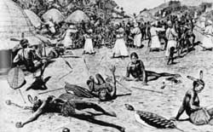
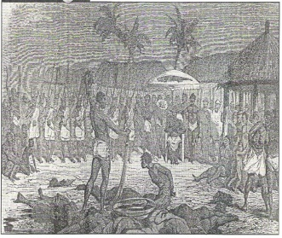
Life in Africa before the Europeans
Activity 1
Complete the mind map by including key facts to show what life was life in Africa before the Europeans came. (Add in your own branches to show extra knowledge.)
Wars/
Kingdoms
Slavery
Africa before the Europeans
Society
structure
Culture

Slide 4
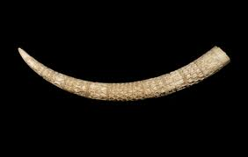
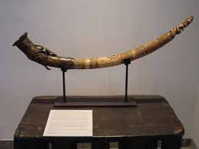
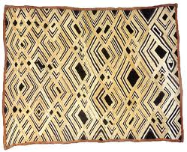
The Europeans arrive in Africa…
Activity 2
When the Europeans arrived, Africa was full of strong states and strong rulers. They were too powerful to be invaded.
Therefore, peaceful trade took place. Initially the Europeans wanted goods from the Africans, like the ones below:
What are these objects?
What are they made from?
What skills were required to make them?
Why might the Europeans have traded these goods?
What other objects would Africans trade with Europeans?

Slide 5
Why were Africans chosen for slavery?
Activity 3
In the space below draw and label images to show the reasons why Africans were chosen. Think of as many reasons as you can!

Slide 6
The Europeans begin to trade slaves with Africa
Activity 4
Events and discoveries in the New world of the Americas changed the trading relationship.
Europeans needed workers for their colonies in the Americas. The American natives were seen as weak and unable to do the work.
The Europeans exploited the African systems of slavery and transformed it into a large scale structured system. In this human beings were treated as property to be traded and forced to labour without any rights at all.
Watch the video clip and use this box to explain how slaves were captured.

Slide 7
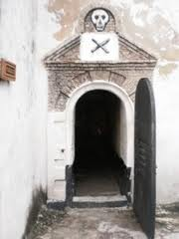
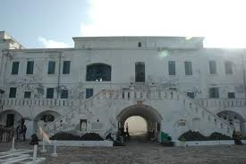
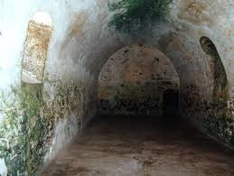
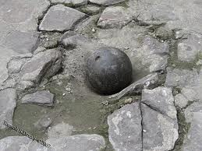
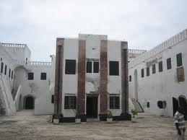
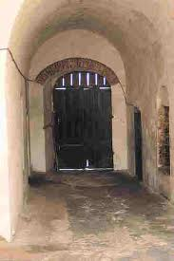
Elmina Castle – where the slaves were kept
Activity 5
Look at the pictures of Elmina Castle and make notes on the slaves’ experiences.
,
cell
Captains quartersl
dungeon
Canon ball
Chapel
Door of no return

Slide 8
Elmina Castle – a slave’s experience
Activity 6
Imagine you are a freed slave writing an autobiography. In the space below write an account of your experiences at Elmina Castle.
,

Slide 9
Activity 6 continued
,

Slide 10
The Middle Passage
Activity 7
Watch the video clip and then complete the ’Senses Map’ to record the experiences of a slave on the journey across the Atlantic Ocean. It has been started for you ….
,
Smell
Taste
Touch
Hear
See
Slaves groaning in pain.
Mothers crying for their children.

Slide 11
Notes Page

Slide 12
Extra Activities
SLAVERY - ODD ONE OUT
Task – Read the 6 different sets of words and circle the word you believe is the odd one out. Be prepared to discuss your choices with the rest of the class.
SET 1 | Britain | Africa | India | America
SET 2 | Guns | Slaves | Pots and pans | Cloth
SET 3 | Cages | Wrist shackles | Neck rings | Thumbscrews
SET 4 | Whipping | Washing | Dancing | food
SET 5 | Dungeon | chapel | Canon ball and chain | Captains quarters
SET 6 | Cannibals | Non-Christian | Strong | No proper language
Anagrams – can you unscramble the words
One item brought to Britain | C A O T C B O | Name given to a buyer and seller of slaves | D R R T E A
Slaves were kept in these before boarding the ship | S G C E A | Name of the journey from Africa to America | M P I A D D S S A G E L E
A piece of equipment used to control slaves | G R E S C I K N N | What did the traders make the slaves do to keep fit | C D E N A
The term for putting slaves on their sides in the ship | G T T H I K P C A | This is what happened to dead slaves on board | H R W O N T O R B O A V E D R

