Slide 1
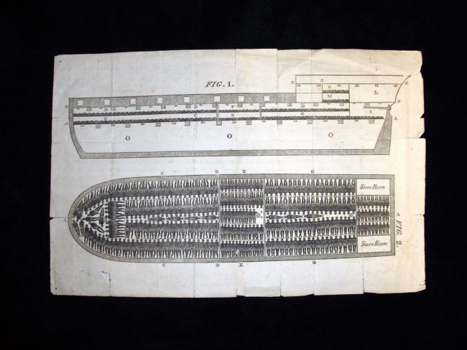

Slide 7
How do they compare with Olaudah Equiano’s experiences which he wrote in 1789?
I was soon put down under the decks, and there I received such a salutation in my nostrils as I had never experienced in my life: so that, with the loathsomeness of the stench, and crying together, I became so sick and low that I was not able to eat, nor had I the least desire to taste any thing. I now wished for the last friend, death, to relieve me;

Slide 8
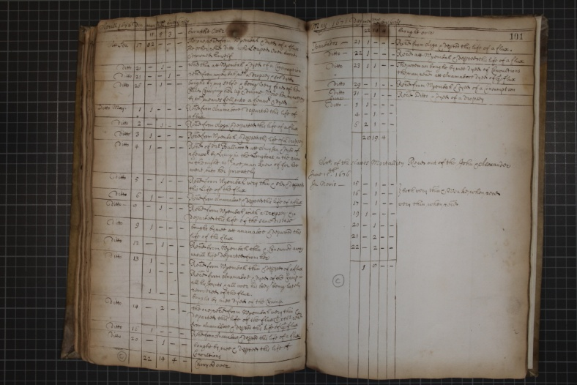

Slide 9
Broken Hearts?
An extract from the record books of a slaving ship from 26th April 1676: The captain records the death of a slave woman:
bought by my selfe being very fond of her
Child Carrying her up& downe Wore her to nothing
by which meanes fell into a feaver & dyed

Slide 10
SUICIDES? 1
List of slave deaths from the slave ship log book for April 1676
Aprill 1676 | day | men | Wo men | boys | Girls
 |  | 11 | 5 | 3 | _ | brought Over
Att Sea | 17 | 02 | _ | _ | _ | The one was from Wyembah & died of a flux. The other received ditto who Leaped over board & drowned himself

Slide 11
SUICIDES? 2
Another extract from the same log book for 4th May 1676; another man:
Received of Mr Ballwood att Amy? & dyed of
a feaver by Lying in the Longboat in the rain
in the night which no man knew of for hee
went into her privately

