Slide 1
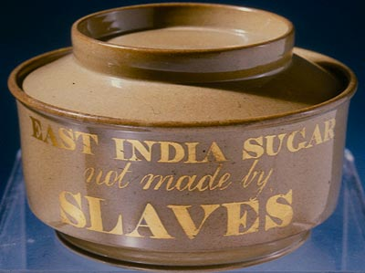
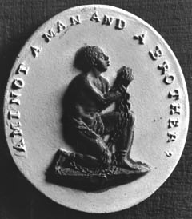
Why did the abolitionists produce these artifacts?

Slide 2
Questions to Consider
What are these items? Who would have purchased them?
Who would have been behind the creation of these artifacts?
What ideas are being expressed? Compare and contrast.
What audience is being addressed?
Why would that audience have been important to reach?
What impact would you expect these to have? Evaluate which you believe would have been more effective and why.

Slide 3
