Slide 2
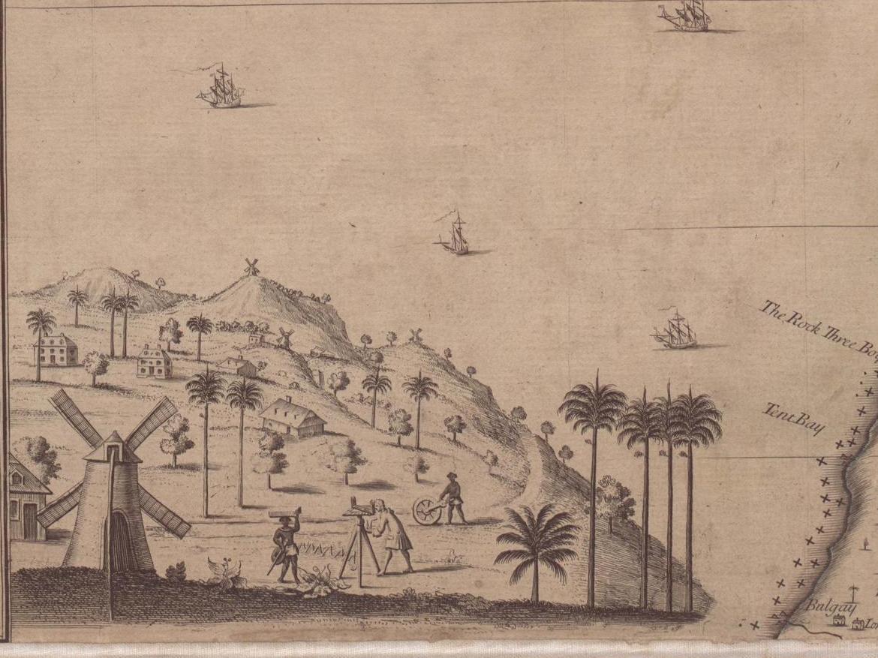
…tis impossible to do without Liquor
Developing engaging enquiries into the transatlantic slave trade
Andrew Payne Head of Education & Outreach The National Archives of the United Kingdom

Slide 3
Assemble the following into the correct order
disapprove of the Traffic in Slaves from Africa, is known to all; as well as that it
Slaves. That our humane and equitable Sovereign, and the British Nation,
compulsive transfer of your persons by your own Countrymen, by whom you
were held in bondage in your Native Land, and were there disposed of as
has consequently been prohibited by the Law and has long ceased.
Slavery is not the institution of any particular Colour, Age, or Country: - it has
personally known to all of you who have come from Africa under the
ever existed, and does still exist, among White as well as Black Men, in every
and, with the Whites, have been its joint authors in the West Indies, is a fact
quarter of the Earth. – That the Blacks of Africa have countenanced Slavery,

Slide 4
How did you do?
Slavery is not the institution of any particular Colour, Age, or Country: - it has
ever existed, and does still exist, among White as well as Black Men, in every
quarter of the Earth. – That the Blacks of Africa have countenanced Slavery,
and, with the Whites, have been its joint authors in the West Indies, is a fact
personally known to all of you who have come from Africa under the
compulsive transfer of your persons by your own Countrymen, by whom you
were held in bondage in your Native Land, and were there disposed of as
Slaves. That our humane and equitable Sovereign, and the British Nation,
disapprove of the Traffic in Slaves from Africa, is known to all; as well as that it
has consequently been prohibited by the Law and has long ceased.

Slide 5
Provenance & Purpose
Who wrote this?
When?
Who is the intended audience?
For what purpose was it written?
What clues are there in the source to support your theory?

Slide 6
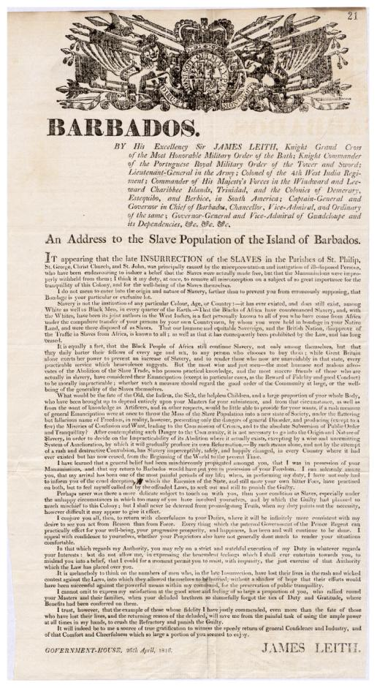
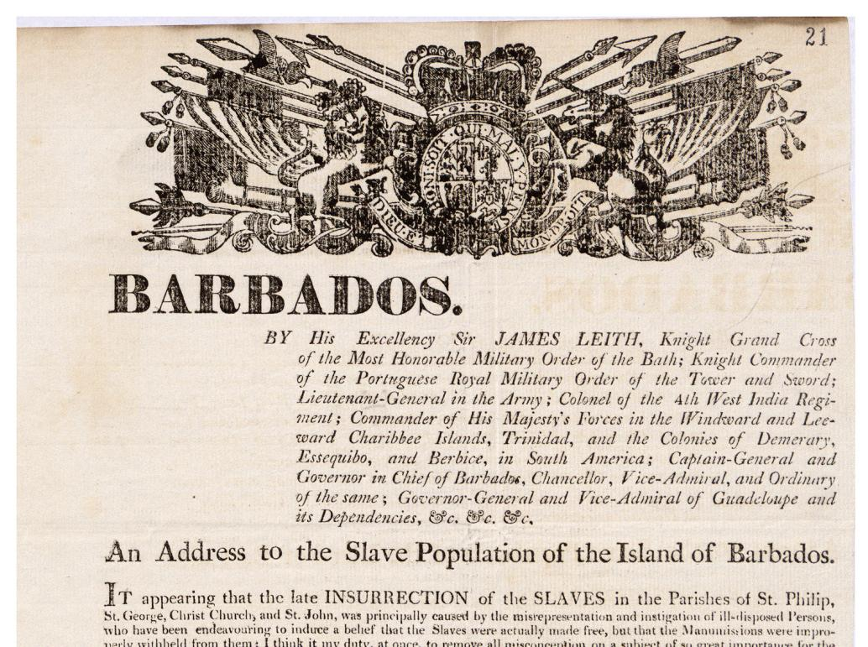
James Leith – Governor of Barbados April 26th 1816 Cat Ref: CO28 / 85 / 009

Slide 7
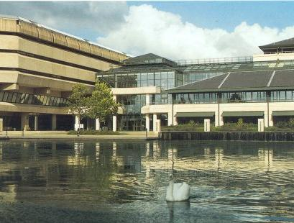
Welcome to your new resource cupboard

Slide 8
The National Archives’ Public Task
Our responsibility is
for the government record, its past and future, its use and re-use,
authentic, available and accessible to all
Notes:
And that is why, with the exec team and the management board, we have defined our public task, very simply and clearly.
We will fight for the public record. We’ll be there.
In a tough funding environment for information and records management in government. Where departments have a huge volume of information assets to keep. When the archive sector across the country needs our help to ensure that they can meet their obligations to the record. When the public partly depend on us to get access to the transparent government they deserve.
Our role is fundamental. We have the credibility to do this. And we have an important part in the government’s transparency agenda, as the front-line service for the public record

Slide 9
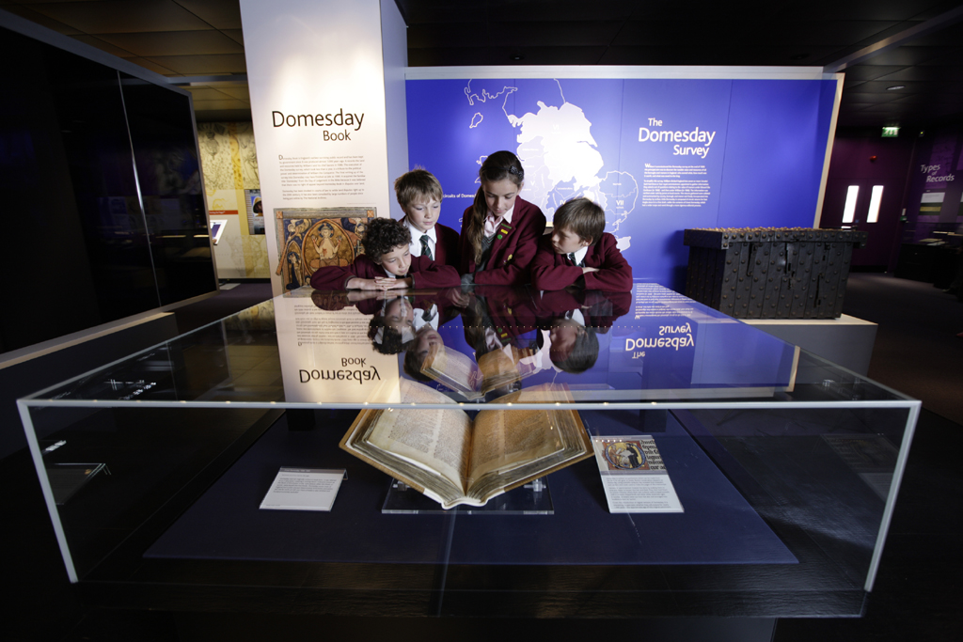
The National Archives’ Public Task … to make people think!

Slide 10
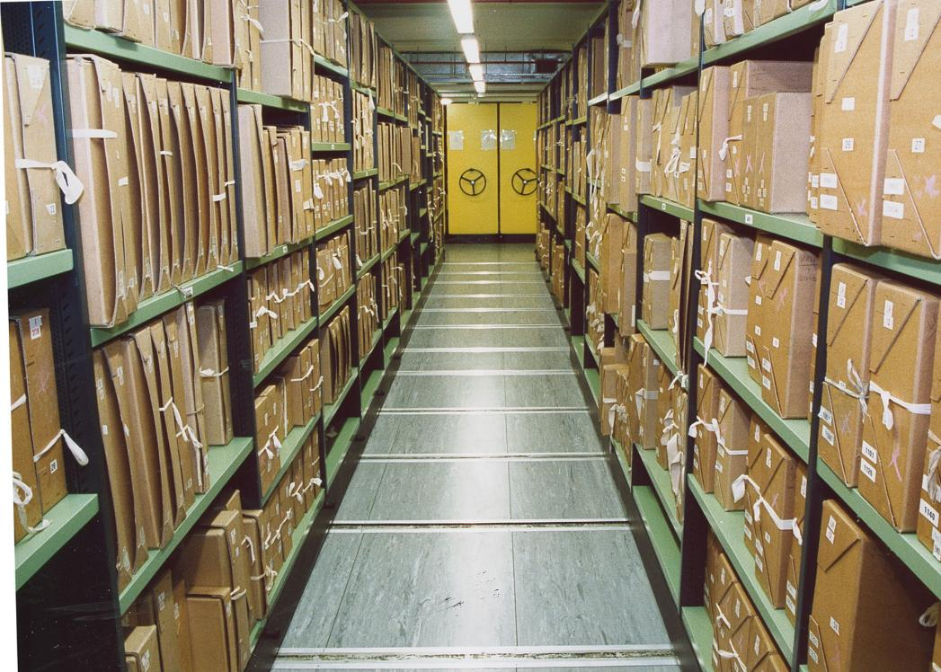
11,000,000 boxes

Slide 11
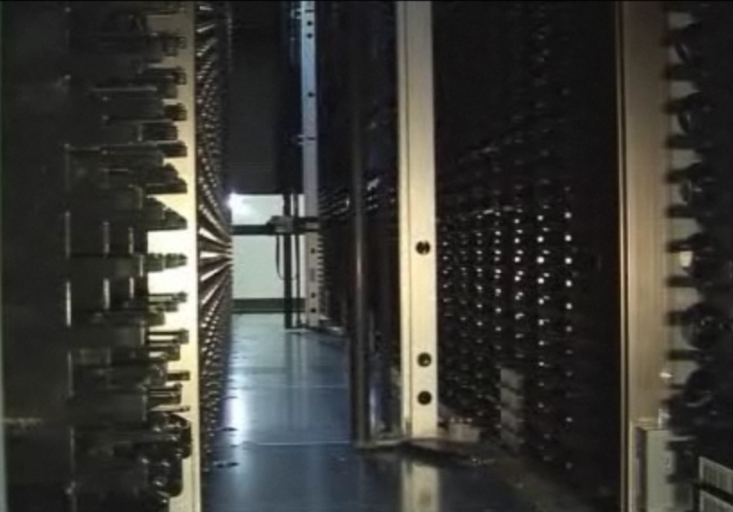
1 quadrillion bytes – 1 Petabyte of storage

Slide 12
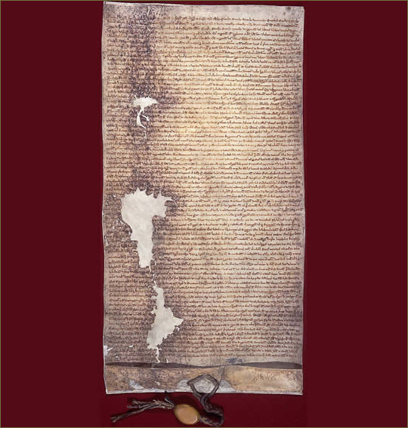
Magna Carta - 1225

Slide 13
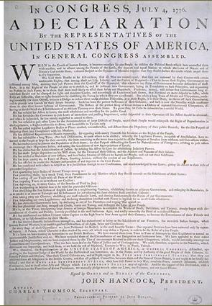
Declaration of Independence - 1776

Slide 14
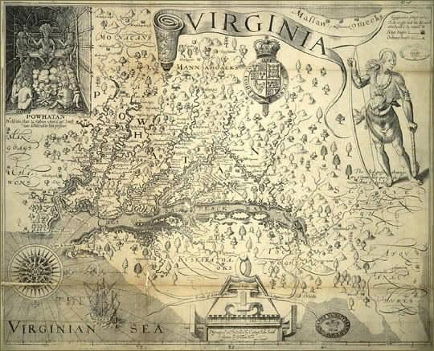
William Hole Map of Virginia - 1612

Slide 15
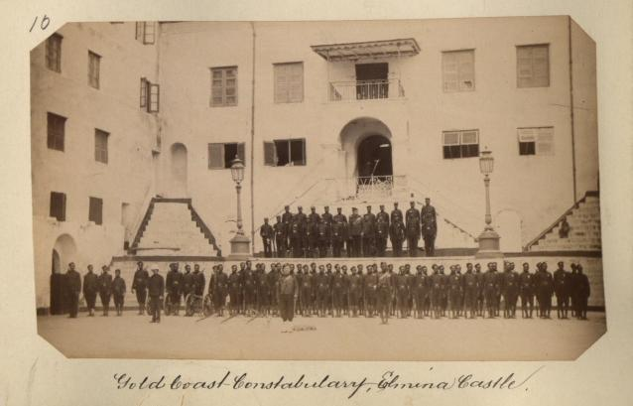
Ghana’s First Police Force – 1890s

Slide 16
Henry Cole’s Rat - 1838

Slide 17
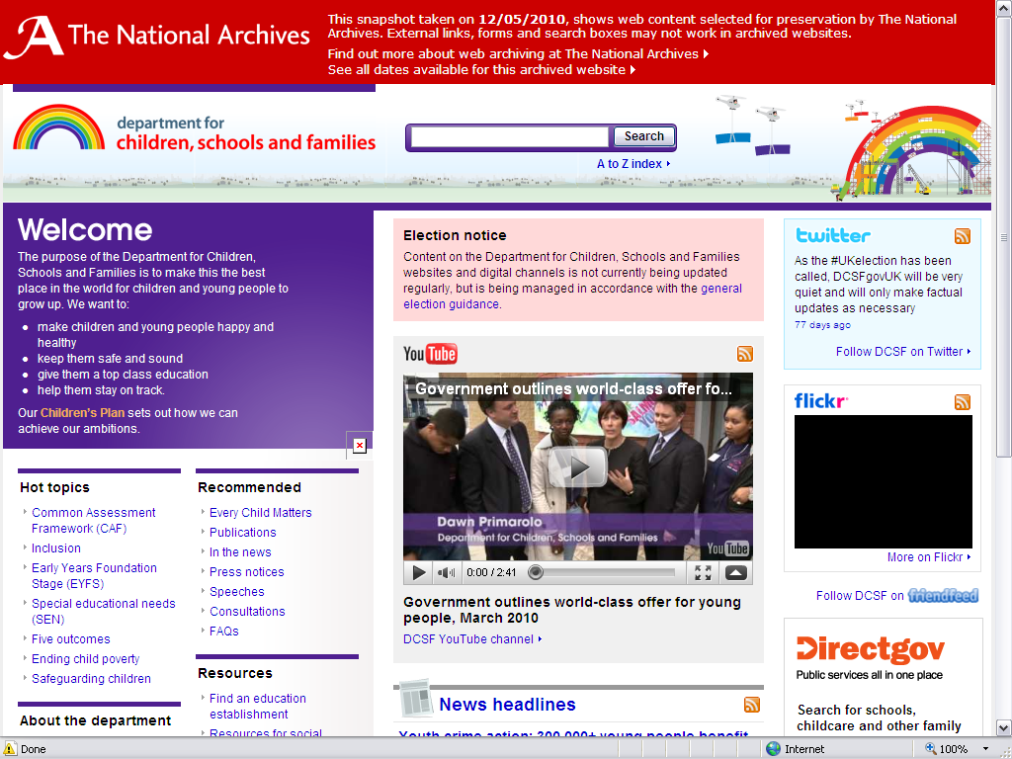
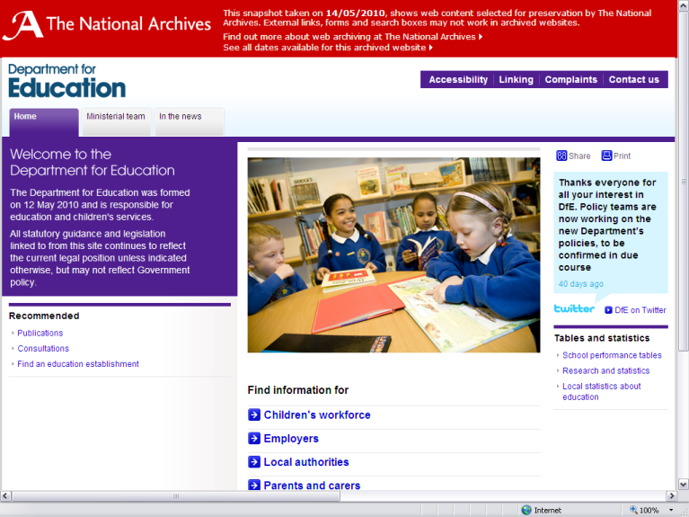
UK Government Web Archive

Slide 18
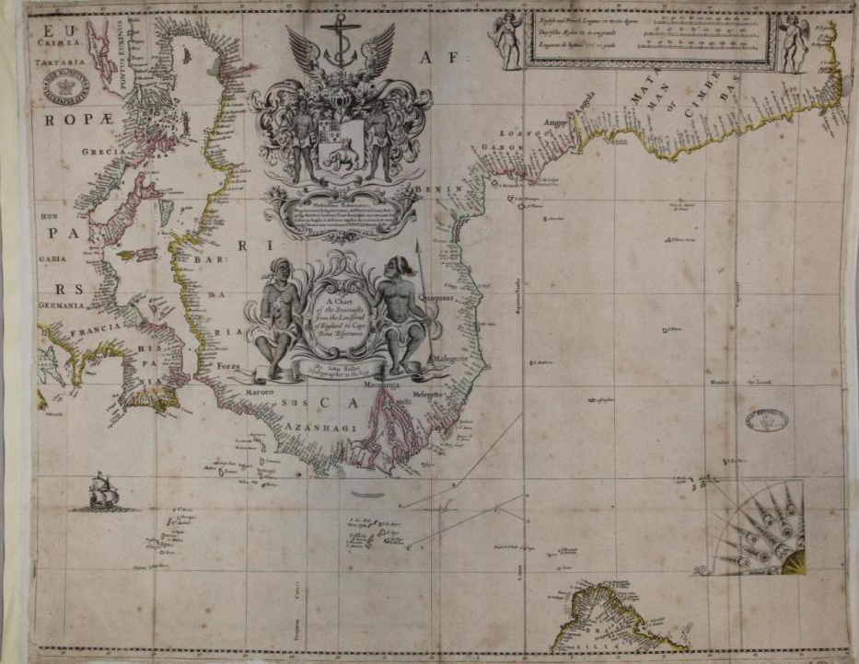
The Past is an Alien World …so how can we teach about slavery and the slave trade?

Slide 19
Engage Prior Understanding (or Ignorance)
“Students come to the classroom with preconceptions about how the world works. If their initial understanding is not engaged, they may fail to grasp the new concepts and information…”
Suzanne Donovan & John Brandsford How Students Learn p.1 National Academies Press 2005

Slide 20
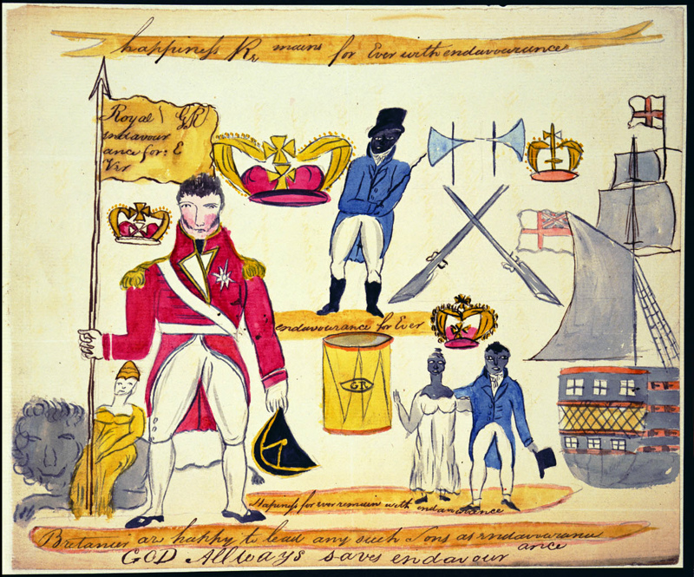
Provenance & Purpose?

Slide 21
Cat Ref: MFQ1/112

Slide 22
“an extraordinary emblematical flag” Colonel Edward Codd to James Leith, his report of the insurrection April 25 1816 (Cat Ref: CO 28/85)

Slide 23
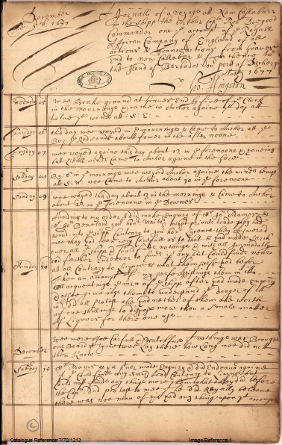
Predict the voyage of The Arthur
T 70/1213
A Journal of a voyage to New Calabar in the ship the Arthur, Captain Robert Doegood Commander. An the account of the Royal African Company of England of all actions & transactions from Gravesend to New Calabar & from thence to the Island of Barbados, our port of discharge December The 5th 1677 Signed: George Hingston
www.nationalarchives.gov.uk/slavery/learn-more.htm

Slide 24
Engage Priory Understanding

Slide 25
Predict the Journey of the Arthur
Mark the departure of the Arthur from Gravesend –
5am Wednesday 5th December 1677
Mark predictions on your calendar for the following:
How long it took to get to New Calabar
How long was spent trading around the West African coast
How long it took to cross the Atlantic to Barbados
The date of arrival in Barbados
Time to disembark all Africans and materials

Slide 27
Predict the Journey of the Arthur
Add predictions for key events during the voyage to New Calabar
Weather
Sightings
Encounters
Add predictions for key events whilst in West Africa
Weather
Encounters with Africans – friendly, hostile?
What was traded and how?
Problems/difficulties/dangers for Africans? For crew?

Slide 28
Predict the Journey of the Arthur
Add predictions for key events whilst crossing the Atlantic
Weather & encounters
Problems/difficulties/dangers for Africans? For crew?
Add predictions for key events on arrival in Barbados
Activities /problems
Predict the following
Total number of Africans transported
Total number of African deaths
Total number of crew deaths

Slide 29
Step 2 – test your predicted narrative against the real narrative
Investigate the Journey of the Arthur
Skim the transcript looking for factual details to support or counter your predictions
Mark the factual details on the second calendar
Compare the two calendars and score your accuracy of predictions from 1 (poor) to 5 (excellent)
What did you accurately predict?
What did you partly predict?
What did you not predict at all?
Do you find anything surprising or shocking about the journey of the Arthur?
What would you like to investigate further?

Slide 30
Voyage of the Arthur
Departs Gravesend Wed 5 Dec 1677
Arrives New Calibar Sun 10 Feb 1678 (9½ weeks)
Cruises West African coast to Sun 14 Apr 1678 (9 weeks)
Departs Cape Lopez Mon 15 April 1678
Arrives Bridgetown, Barbados Wed 22 May (6 weeks)
Hingston leaves ship Sat 1 Jun (1½ weeks)
Total Africans Transported – 374
Total Africans Died – 82
Total Crew Died - 3

Slide 31
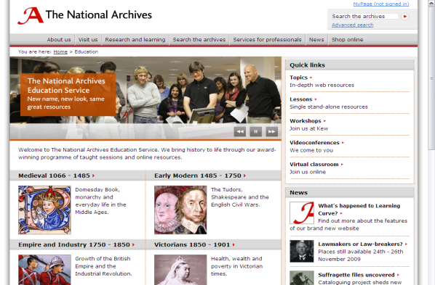
www.nationalarchives.gov.uk/education

Slide 32
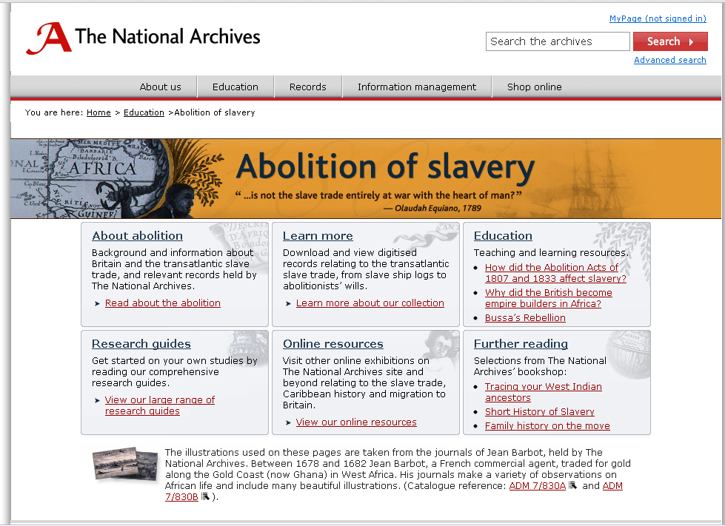
www.nationalarchives.gov.uk/slavery

Slide 33
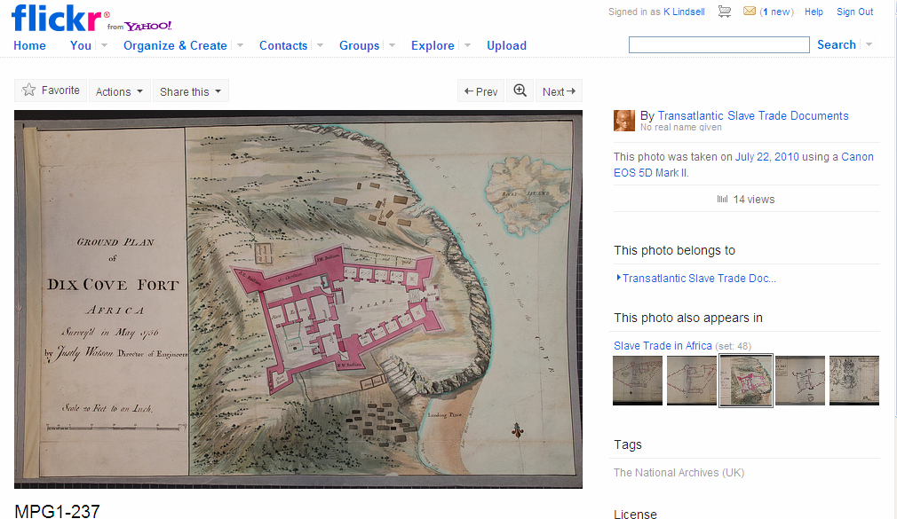
www.flickr.com/photos/52115725@N03/

Slide 34
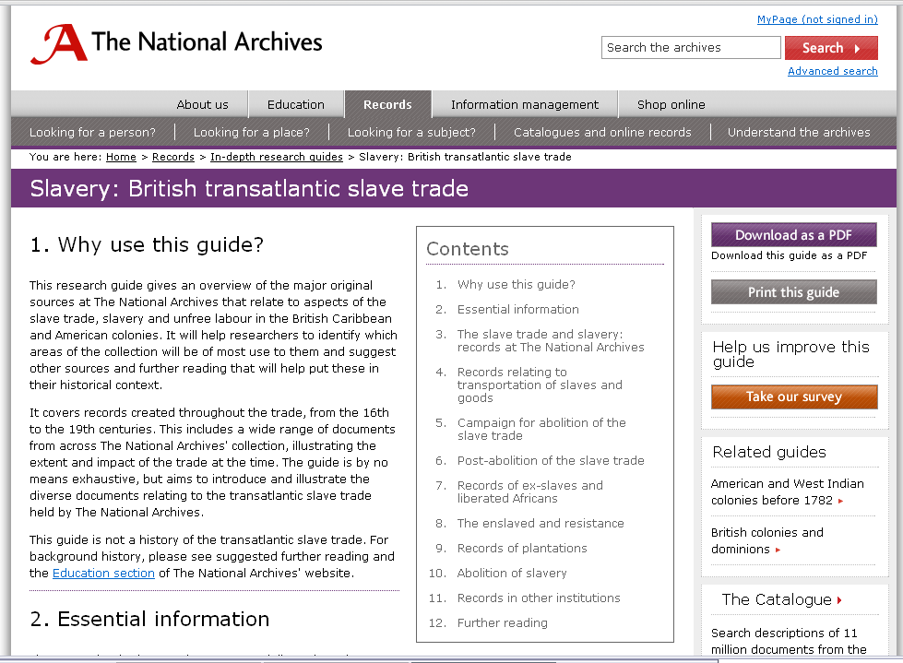
www.nationalarchives.gov.uk/records/research-guides/slave-trade-slavery.htm

Slide 35
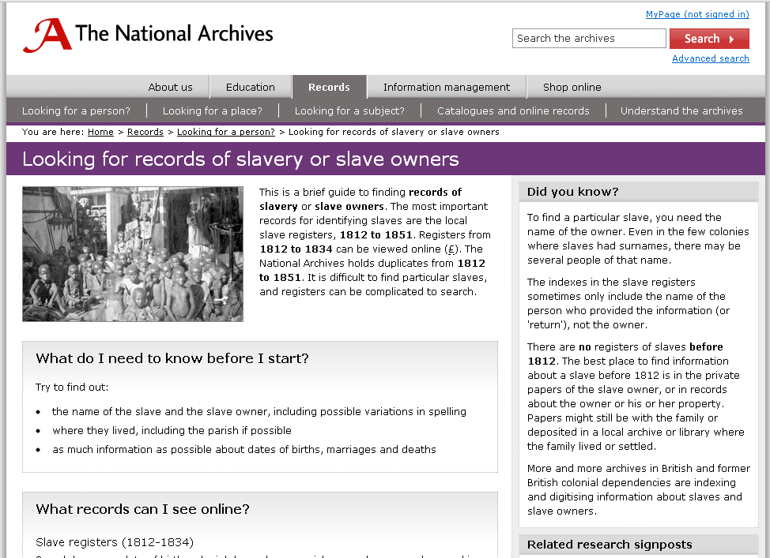
www.nationalarchives.gov.uk/records/looking-for-person/slaves-and-slave-owners.htm?WT.lp=rg-3163

Slide 36
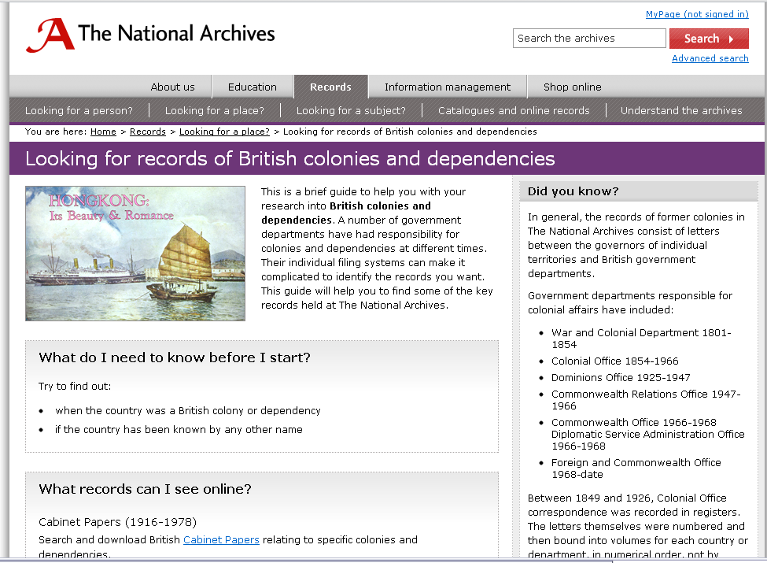
www.nationalarchives.gov.uk/records/looking-for-place/coloniesanddependencies

Slide 37
Andrew Payne Head of Education The National Archives
andrew.payne@nationalarchives.gsi.gov.uk
020 8392 5319
www.nationalarchives.gov.uk/education

